Slide 1

Who is actually winning ?
Authors: Gautam Shende, Pradeep Aitha, Sujit Singh
CSE 712: Human Decision Making and Machine Learning
Instructor: Dr. Kenneth Regan
Date: 05/19/2018

Slide 2
OVERVIEW
Hypothesis
Model and Methodology
Biases and limitations
Results & Inferences
Final Conclusion
Future Scope
References

Slide 3
Hypothesis

Slide 4
Hypothesis
Stockfish evaluation alone can not determine “who is winning”.
A more comprehensive approach is needed for predicting an ‘Who is winning ?’. This requires to consider a lot of other factors.
Example :
Kasparov(Opening) vs Karpov (Endgame)
Kasparov having early advantage does not signify winning
Karpov having early advantage does signify a better chance

Slide 5
2) Model and Methodology

Slide 6
Model
Features:
Input is details about a move
ELO: ELO_White, ELO_Black
Turn: Turn, Move#
Positional arguments:
QueenWhite, QueenBlack, RookWhite, RookBlack, BishopWhite, BishopBlack, KnightWhite, KnightBlack
Evaluations:
Stockfish Bestmove_Eval
General Info:
PlayerNames, Year, Type of tournament

Slide 7
Methodology
1. DataSet:
AA_..._.txt files from metallica
~74 Files
~7 Million Moves
~1 Million Moves used for training Large Model
~100,000 Moves used for training Small Model (Flexibility)
2. Parsing:
Regex and lambda for processing input from files
Filtering:
- Drop Cities
- Tournament filtering (U,Men,Women,General)
- removing empty entries in ELO (unr) and Year (?)
- Player name hashing
- Parse FEN

Slide 8
Methodology
3) Major steps:
Ran Random Forest Classifier and Regressor after selecting 1 Million Random Moves from the original 7 Million data set.
Classifier was used in both Models(Large and Small) and Regressor was used only in the smaller model.
Testing of how exclusion and inclusion of different parameters affects prediction in the model.
Testing whether using only stockfish evaluation is good enough ?

Slide 9
Methodology
3) Major steps(contd):
(Work in Progress)
Building a front end:
Model simulation (Output of a given input )
Live Game Analysis

Slide 10
3) Biases and Limitations

Slide 11
Biases and Limitations
Limited ELO differences. Model wouldn’t be too appropriate for high ELO difference
Feature variance. Example: More data in fixed range of ELO (~2200 to 2600 range)
Limited Data Set (~ 1 million in Large model and ~100,000 in Smaller)
Games fixed around recent years. More data from recent years. (Which is not that bad
Hashing names limited to hashing function (Time vs accuracy tradeoff). Use other method for identifying person (Birth date + name hasing for example is more accurate)

Slide 12
4) RESULTS & INFERENCES

Slide 13
Random Forest on Large Dataset
Random Forest Classification of games on testing set for large data set ~ (100,000)
Accuracy: 0.6566
Immediate Observations:
White wins are more, draws are max and Black wins are least
Max misclassifications are for draw (~16k), followed by White(~11k) and Black(~7k).
 | Classified B | Classified D | Classified W
Black Wins | 16373 | 7243 | 3740
Draw | 4554 | 25989 | 6991
White Wins | 2827 | 8984 | 23298

Slide 14
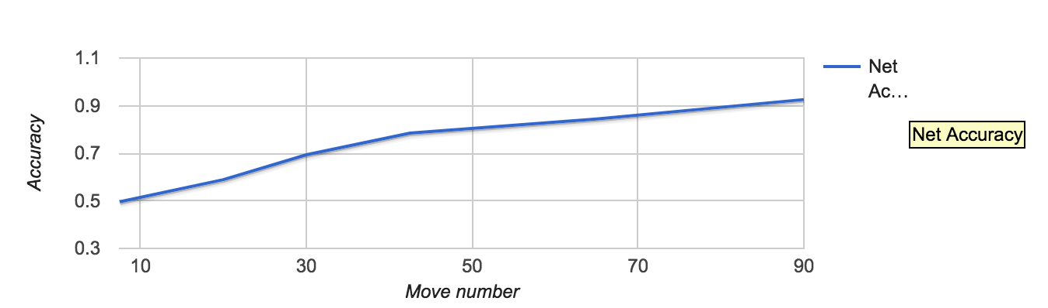
Accuracy of large set with Move #
Accuracy increases with increase in number of moves as expected (Very hard to predict who is going to win in initial stages).

Slide 15
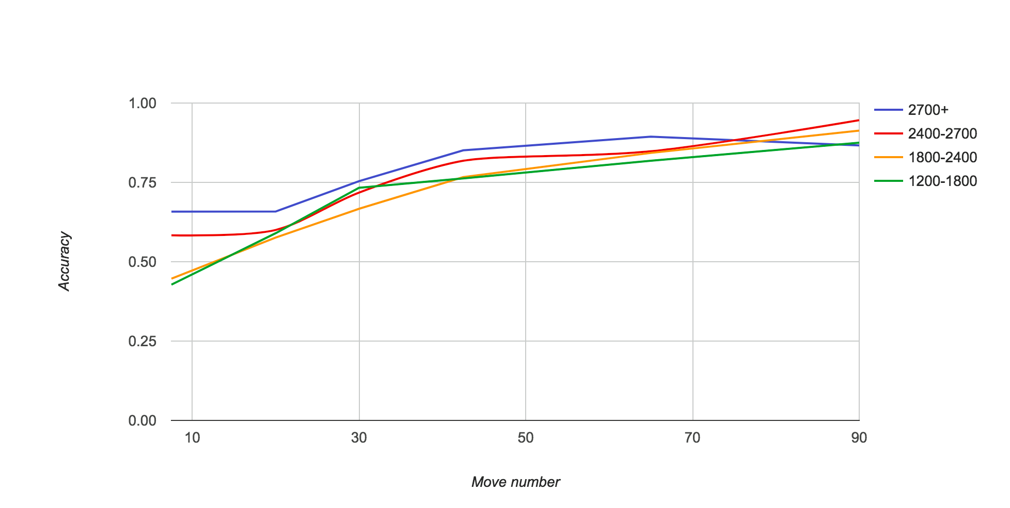
b) Accuracy vs Move # for different ratings

Slide 16
b) Accuracy vs Move# Inferences
Inferences:
Accuracy is maximum for Highest ELO ratings (2700+) until the endgame.
Accuracy of GrandMaster range (~2400-2700) starts at second and ends up at the top towards the end game
The ranges between (1200-1800) and (1800-2400) keep fluctuating
Important inference is that it is easier to predict outcomes as we go higher in the ratings

Slide 17
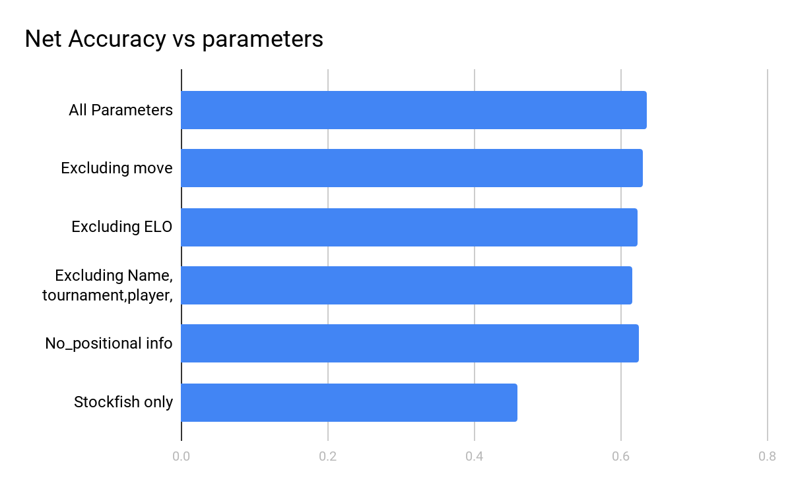
c) Accuracy vs Move # for different ratings (smaller data)
Params | All params | move’ | ELO’ | (name,tourn,year)’ | Positional info’ | Stockfish only
Accuracy | 0.636 | 0.63 | 0.623 | 0.616 | 0.625 | 0.458

Slide 18
b) Accuracy vs Move # for different ratings
Inferences:
Excluding name tournament and year which we thought wouldn’t have much impact on accuracy has actually the most impact
Excluding ELO was second most impactful and strongest when we consider individual features (as expected)
Excluding move number and Move position did result in slight drop in accuracies but those were even more insignificant

Slide 19
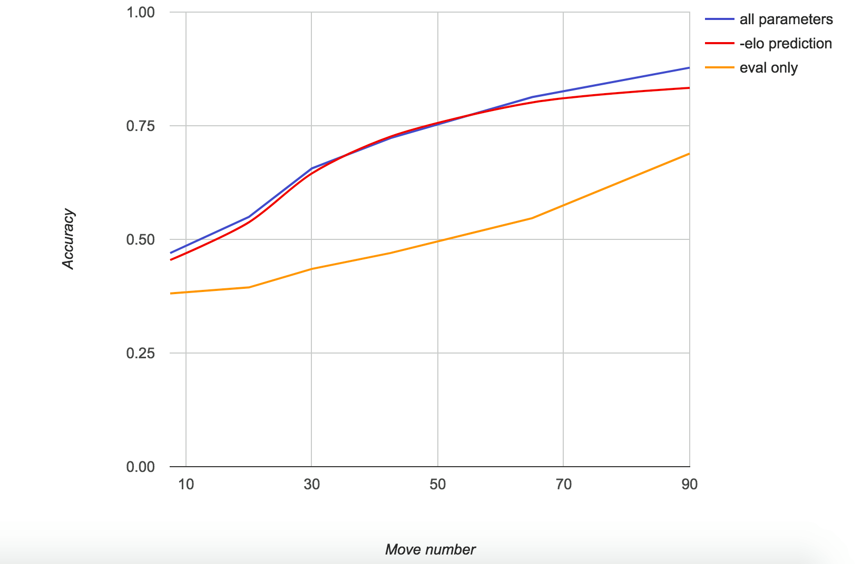
d) Dropping ELO

Slide 20
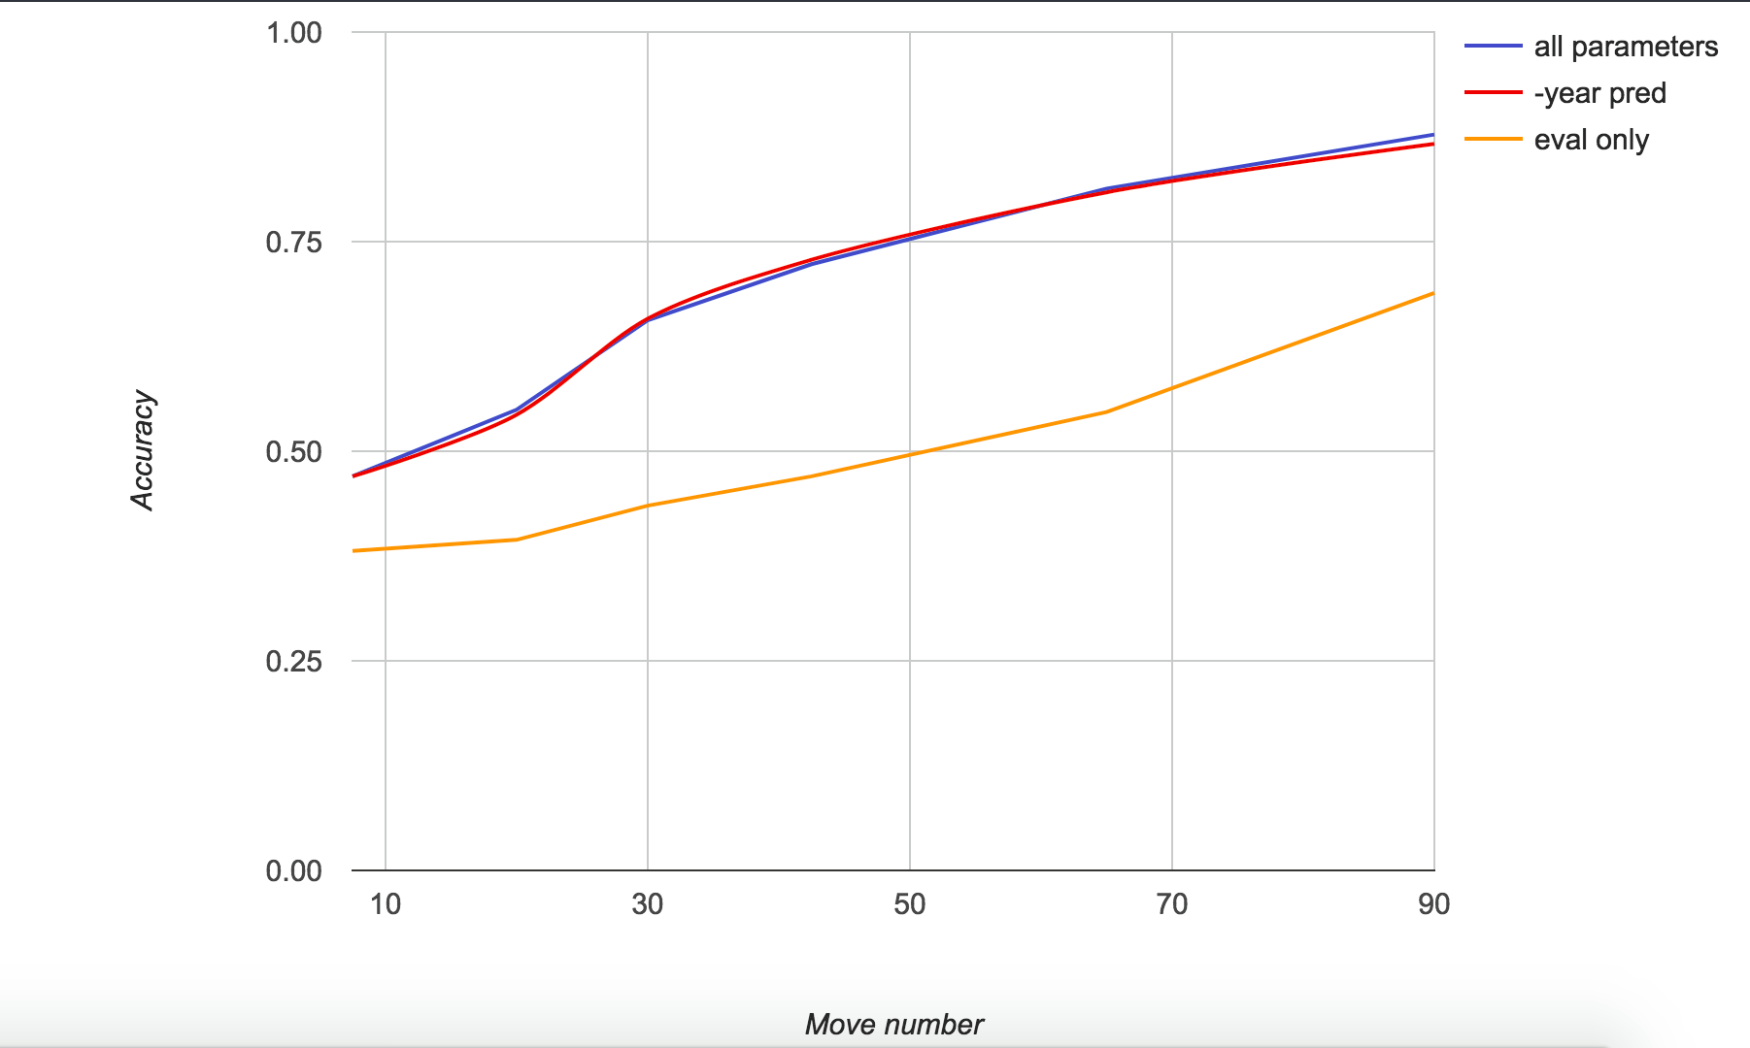
e) Dropping year

Slide 21
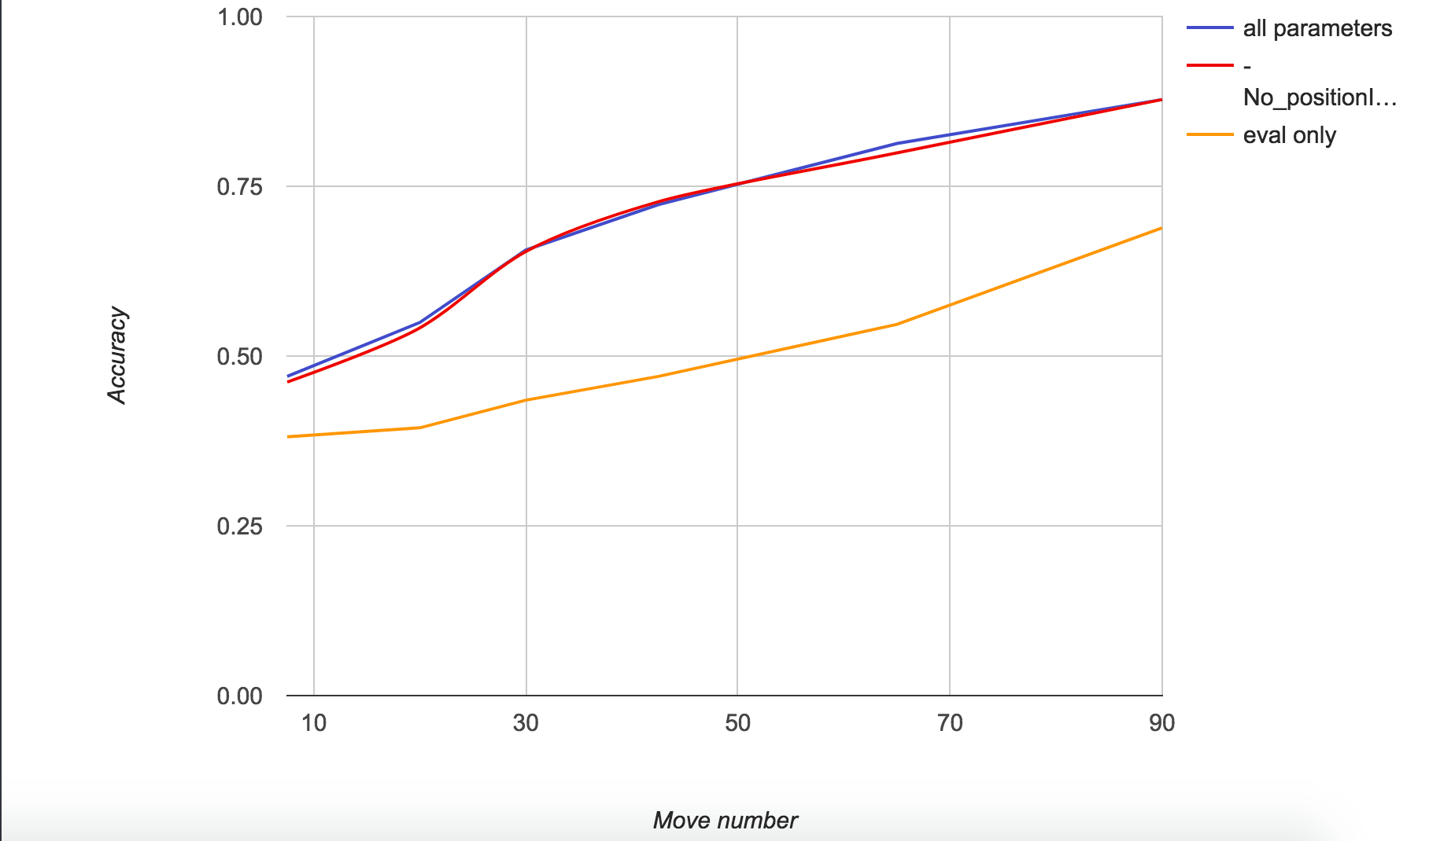
f) Accuracy vs Move # for different ratings

Slide 22
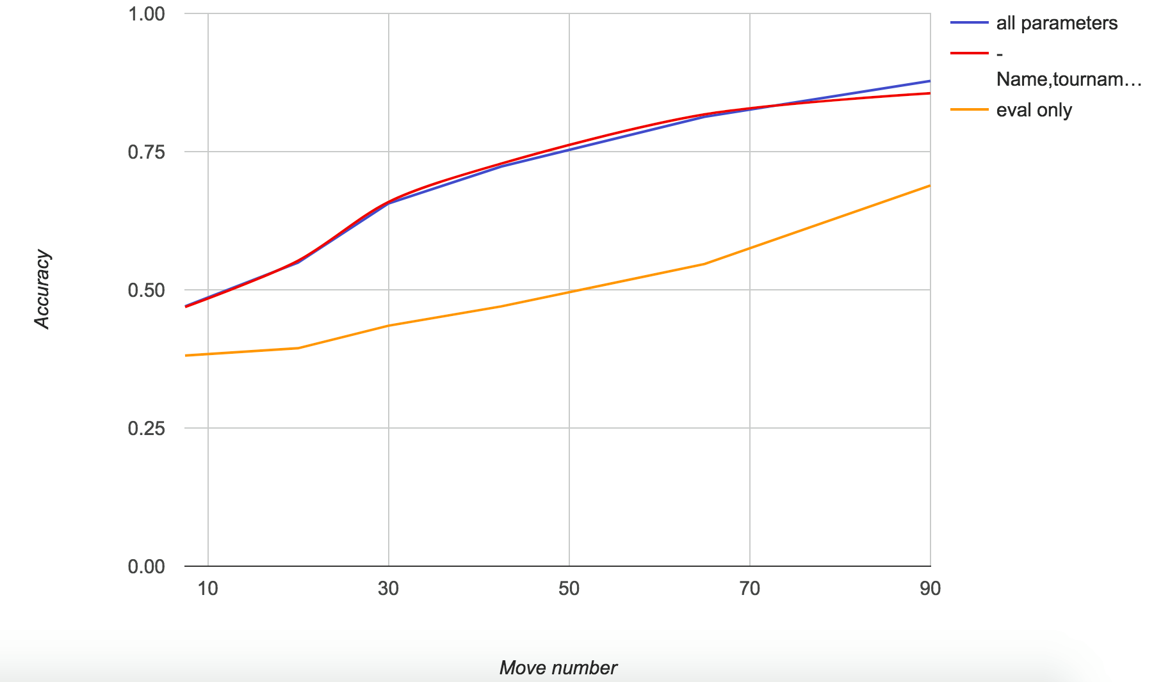
g) Dropping Name, Tournament, Year

Slide 23
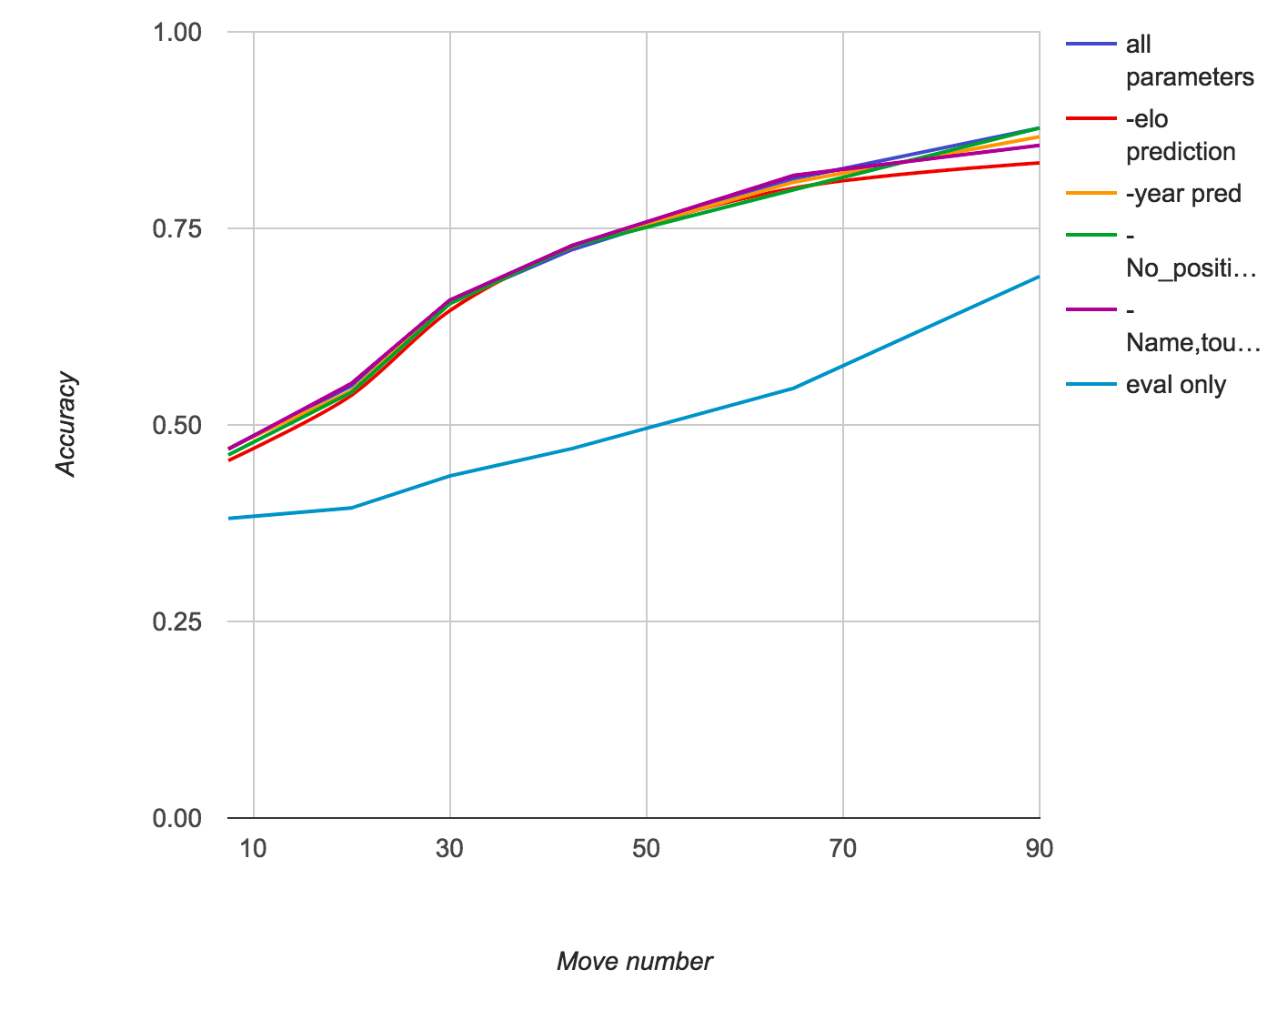
h) Everything one one graph (A mess!)

Slide 24
i) Dropping parameters inferences
Inferences:
Dropping one or two parameters doesn’t affect the model much
Only slightly significant observation is that in really higher ELOs (2700), knowing the ELO doesn't help in predicting outcome towards the endgame.
Dropping all parameters does have significant impact on the accuracy

Slide 25
5) Final conclusion

Slide 26
Conclusion
Using just stockfish evaluation for predicting results is surely one of the best features to consider
However, considering other features certainly helps in yielding a more comprehensive
Practical ?
Not that much!
Maybe 2 or 3 features can be considered however increasing parameters more than that doesn’t yield a significant increase in performance in comparison to the increase in running time.

Slide 27
6) FUTURE SCOPE

Slide 28
FUTURE SCOPE
Including Player type (maybe from some other group_ as a parameter
Do it for specific 20 players so model can analyse their game in detail. How do parameters now affect the accuracy ?
3) Using AWS for running 7 million data file

Slide 29
7) REFERENCES

Slide 30
REFERENCES
Moves Dataset - Dr. Kenneth Regan (metallica.cse.buffalo.edu)
Scikit-learn.org
https://machinelearningmastery.com/save-load-machine-learning-models-python-scikit-learn/
Chess24.com (Scraping)

